Slide 1
Systematic desensitisation
classical and operant conditioning; systematic desensitisation, including relaxation and use of Behavioural therapies
hierarchy; flooding.
  Aversion
  Immersion (flooding)
  systematic de-sensitisation

Slide 2

Aversion therapy. What do you think?

Slide 3
Aversion Therapy
Aversion therapy uses the behavioural approach principles that new behaviour can be 'learnt' in order to overcome addictions, obsessions or, as demonstrated in Kubrick film A Clockwork Orange, violent behaviour.
Patients undergoing aversion therapy are made to think of the undesirable experience that they enjoy, for example, a violent person might be shown images of violent crime, or an alcoholic might be made to drink, while drugs or electric shocks are administered. In theory, the patient will, over time, come to associate their addiction with the negativity of electric shocks or seizures.

Slide 4
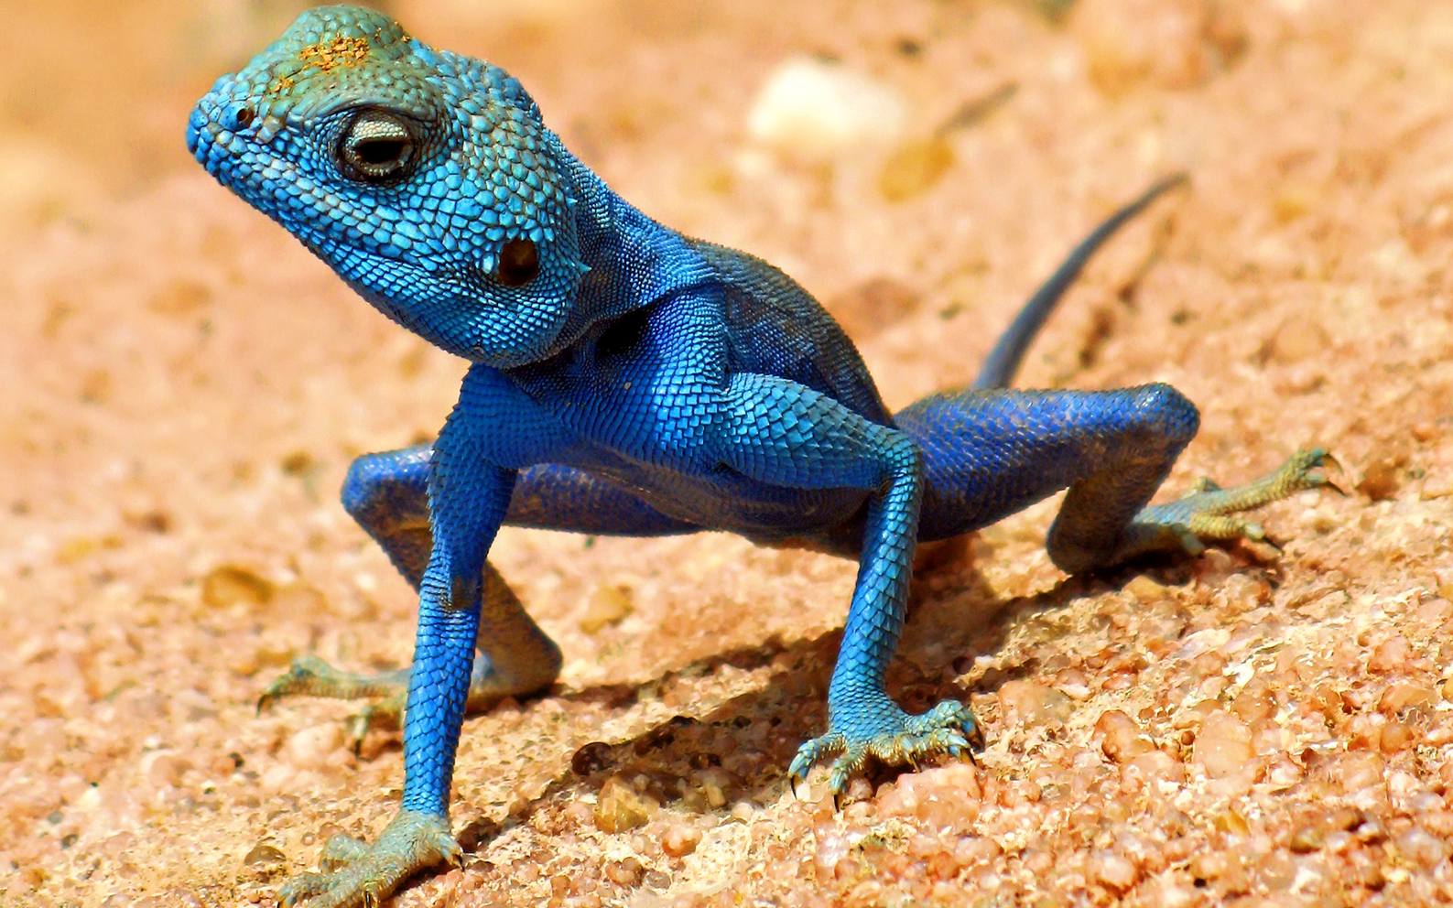
Flooding - what do you think?

Slide 5
Immersion Therapy
The technique is called 'flooding', and it has a solid base in behavioural therapy. The underlying theory behind flooding is that a phobia is a learned fear, and needs to be unlearned by exposure to the thing that you fear.
By definition, a phobia is an unreasoning fear to a non-dangerous thing or situation. Somehow this non-dangerous thing has become associated with the panic response usually associated with mortal danger. By forcing the phobic to confront their fear, therapists reason, they will learn that there is nothing dangerous about it.
Link

Slide 6

Systematic Desensitisation

Slide 7
Mia has a phobia of eating in public. She is about to go to university where she knows that she will have to eat her meals in a large dining hall surrounded by other students.
Describe how a therapist might use systematic de-sensitisation to help Mia overcome her phobia of eating in social situations. (READ)
First the therapist would teach Mia how to relax, using a technique that would allow deep muscle relaxation. Then together the therapist and Mia would construct an anxiety hierarchy, starting with the least feared situation, such as looking at pictures of people sitting at tables in a café just talking and drinking coffee, working up to the most feared situation, such as Mia eating in a restaurant full of people. The therapist would start by showing Mia pictures and helping her to remain relaxed, then perhaps getting her to sit in a café, but without eating anything, and then continuing up the hierarchy until her phobia is gone.

Slide 8


Slide 9
Systematic Desensitisation
First the patient is taught a deep muscle relaxation technique and breathing exercises Second they create a fear hierarchy starting at stimuli that create the least anxiety (Fear) and building up in stages to the most fear provoking images. Third, the patient works their way up starting at the least unpleasant and practising their relaxation technique as they go. When they feel comfortable with this (they are no longer afraid) they move on to the next stage in the hierarchy. If the client becomes upset they can return to an earlier stage and regain their relaxed state.
Why would you use the therapy.
Systematic desensitisation would be used when a person has a phobia as fear is incompatible with relaxation.
A02
SD is of limited use being used mostly to treat specific anxiety disorders such as phobias. Irrational fears of spiders, buttons etc are seen as relatively trivial disorders in comparison to schizophrenia or bipolar disorder where it has little or no effect in treating the disorder.
SD is based on the idea that abnormal behaviour is learned. The biological approach would disagree and say we are born with a behaviour and therefore it must be treated medically.

Slide 10
And again - The Question
‘Behaviourists believe that all behaviour, both normal and abnormal, is learned through processes such as classical conditioning, operant conditioning and social learning.’ Discuss the behavioural approach to explaining psychological abnormality.

Slide 11
The Answer
Answers that only consider therapies, maximum 3 AO1 marks and 3 AO2 marks.
The emphasis of the behavioural approach is on the environment and how the behaviour is acquired, through classical conditioning, operant conditioning and social learning.
For marks in the top two bands, the focus must be on explaining psychological abnormality, rather than on behaviour in general. If no attempt to explain abnormality, maximum 3 marks. Examiners should be aware this might result in quite a wide range of responses being awarded 3 marks. AO2 = 6 marks
Commentary on behavioural approach to psychopathology The commentary can include strengths; such as it has provided some convincing explanations for some disorders such as phobias and has also led to some very successful therapies (systematic desensitization).
The weaknesses are that it ignores the role of biology and there is plenty of evidence to support a genetic transmission of some disorders. An evaluation of therapy could consider whether it is effective and for what disorders. Studies (eg “Little Albert”) can be used as commentary.

Slide 12
What I need to know?
Behaviourism states that all behaviour (including abnormal) is learnt from the environment (NURTURE) Therefore?
Classical Conditioning (little Albert)
Operant conditioning. (Negative and positive) eating?
Social Learning Theory
Phobias
Therapy
  Aversion
  Immersion (flooding)
  systematic de-sensitisation

Slide 13
What is a Phobia. Define
A phobia is an extreme form of fear or anxiety triggered by a particular situation (such as going outside) or object (such as spiders), even when there is no danger.
When is it abnormal.
It stops me living my life. Things that other people do without thought become huge ordeals for me.

